Slide 1
Information Retrieval (IR)- Inverted Index

Slide 2
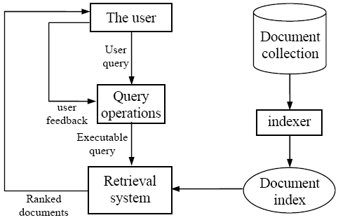
IR architecture

Slide 3
IR queries
Keyword queries
Boolean queries (using AND, OR, NOT)
Phrase queries
Proximity queries
Full document queries
Natural language questions

Slide 4
Information retrieval models
An IR model governs how a document and a query are represented and how the relevance of a document to a user query is defined.
Main models:
Boolean model
Vector space model
Statistical language model
etc

